Slide 1
Quantum Computing Performance Metrics
Rajesh Sathya Kumar

Slide 2
Performance metrics
Scale
Quality
Speed

Slide 3
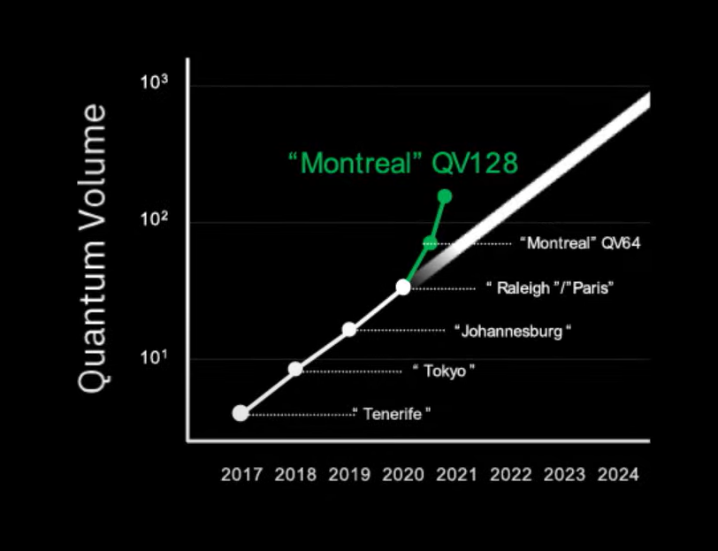
Scale: Measured by the number of qubits. Indicates the amount of information we can encode in a quantum system
Quality: Measured by Quantum Volume which indicates quality of circuits and how faithfully circuits are implemented in hardware
Speed: Measured by CLOPS (Circuit Layer Operations per Second) which indicates how many circuits can run on hardware in a given time.

Slide 4
Quality of QPU’s
Coherence times
Gate Fidelity
Efficiency of the compiler

Slide 5
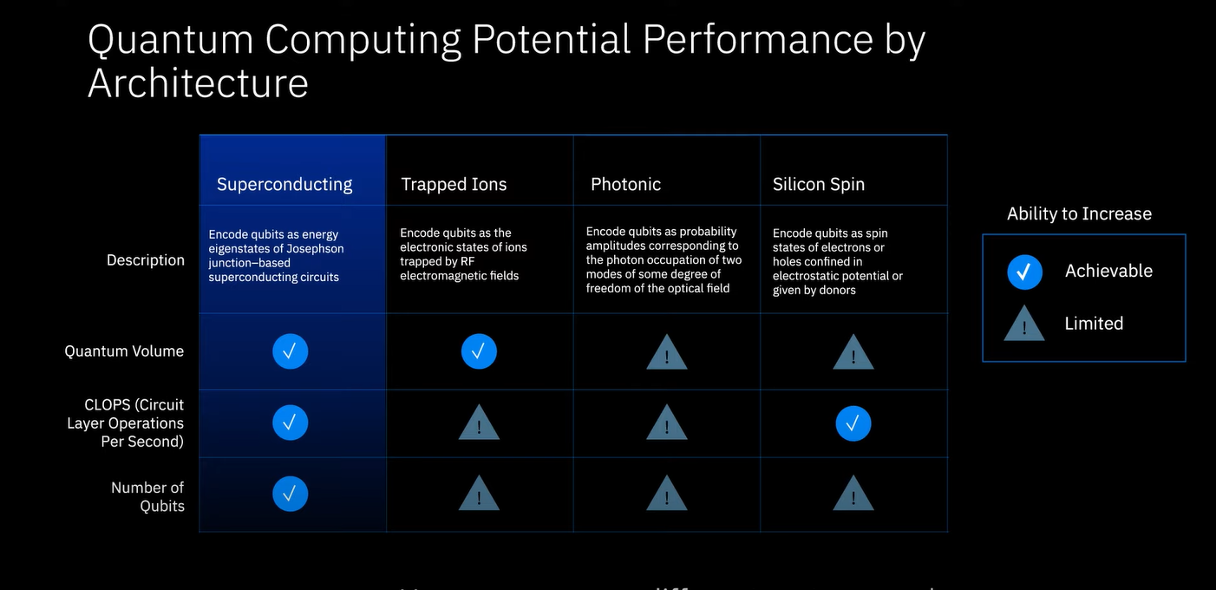

Slide 6
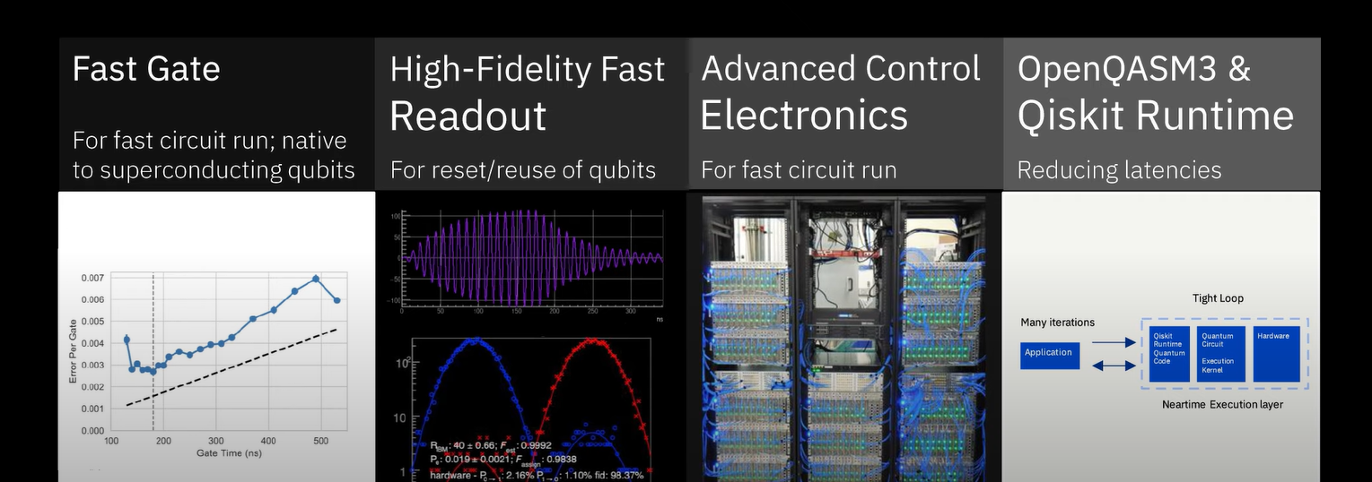
What determines QPU Speed?
Notes:
Fast repeated execution of the Quantum Gates and Readout – Driven by architecture
Advanced Control Electronics – for a quick reset of gates and then reuse of the same
Qiskit Runtime – New Compilation Process, Speeding up of Qiskit SDK
Reducing Latencies, Adding performance across software stack – Improved code generation, pulse orchestration, instrument loading and more efficient interaction with the cloud

Slide 7
Reference:
Quality, Speed, and Scale: three key attributes to measure the performance of near-term quantum computers, Andrew Wack, Hanhee Paik, Ali Javadi-Abhari, Petar Jurcevic, Ismael Faro, Jay M. Gambetta, Blake R. Johnson
Doubling the size of quantum simulators by entanglement forging, Andrew Eddins, Mario Motta, Tanvi P. Gujarati, Sergey Bravyi, Antonio Mezzacapo, Charles Hadfield, Sarah Sheldon

Slide 8
Current literature review:
Quantum Computation and Quantum Information, Michael A. Nielsen & Isaac L. Chuang (Chapter 8: Quantum noise and Quantum Operations)
Quantum Volume, https://pennylane.ai/qml/demos/quantum_volume.html

